Slide 1
Pygame
For Junior Knights
By Rachael Sera

Slide 2
Get Pygame!
The version of Pygame you get must match the version of Python you have.
If you’re using 3.2, make sure Python is downloaded and installed first, and then download and install the pygame after.
Python 3.6.1 and newer now comes with Pygame

Slide 3
Mac Install
Download
Download Python 3.6.1 or greater from python.org
https://www.python.org/downloads/release/python-365/
Install
Open a terminal and type:
python3 -m pip install -U pygame –user
Test
Test it by typing into the terminal:
python3 –m pygame.examples.aliens

Slide 4

What is Pygame?
Pygame is a library that contains modules that allow you to make games
Library examples: math, random, turtle

Slide 5
Why Pygame?
Using the pygame library allows us to do things that would otherwise require a lot of code
e.g. making a window appear on the screen, registering user input of clicks/keypresses, etc.

Slide 6
Pygame can make all kinds of 2D games!
Pong
Asteroids
Snake
Memory
Puzzles
Tetris
Platformer
And more!
https://www.pygame.org/tags/all

Slide 7
Resolution and Color

Slide 8
Window Resolution
Create a window in which the game will run
Choose the size of that window

Slide 9
Resolution
The window size is known as resolution
A common resolution is 640x480, but you can make your window’s resolution any dimensions (less than or equal to your monitor’s resolution!)
Its unit is the pixel

Slide 10
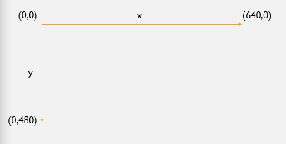
Resolution
Resolution is like a coordinate system
Notes:
If we denote our resolution as (x, y) then the first coordinate, x, is width (horizontal), and the second coordinate, y, is height (vertical).

Slide 11
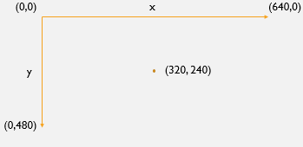
Resolution
The coordinates increase as you go right and down.
The center is (320,240)

Slide 12
Colors
Computers define colors in several ways
RGB, Hexadecimal (hex)
Pygame uses RGB
Red, green, blue

Slide 13
RGB
An RGB value is an ordered triple (r, g, b)
It tells us how much red, green, and blue are in the color
Values range from 0 to 255 (0 is none of that color and 255 is max of that color)

Slide 14
RGB
(255, 0 , 0)
For example, (255, 0, 0) is pure red with no green or blue
(125, 0, 125)
(125, 0, 125) is a purple color because it has equal parts red and blue
(11, 130, 120)
Use any values [0, 255]. (11, 130, 120) is a pretty teal color with mostly green and blue
What would (0, 255, 0) or (0, 0, 255) be?
Notes:
Black is (0,0,0) and white is (255, 255, 255)

Slide 15
Selecting Colors
Google Chrome has a built in tool if you google “RGB color picker”
Search “rgb color chart” to bring up a few websites that have them
Office products also have color visualizers (under More Colors…)

Slide 16
Structure of a Pygame Program

Slide 17
Four Major Parts to a Pygame Program
1. At the top (with any other imports, e.g. random):
import pygame, sys
from pygame.locals import *
2. Before any other pygame code:
pygame.init()

Slide 18
Four Major Parts to a Pygame Program
3. Everything that is done only once:
Initialize the display window
Define constants (e.g. colors)
Initialize variables (e.g. position variables)

Slide 19
Four Major Parts to a Pygame Program
4. Game Loop
Everything that is done every frame:
Draw background, objects, etc.
Get user input (events)
Game physics
Update display:
pygame.display.update()

Slide 20
Game Loop

Slide 21
Game Loop
Everything in your window is redrawn with every cycle of the game loop
Items that appear first in your code are drawn first, and items that appear after in the code are drawn “in front” of them
Notes:
So if you draw a larger object after/on top of a smaller one, you’ll cover up the smaller one (it’ll be drawn, but you won’t be able to see it through the item on top of it)

Slide 22
Code!
Let’s see those 4 categories in action with a simple program to just make a window appear
MakingAWindow.py
Notice the window crashes when we try to close it—that’s because we’re not handling the user clicking the exit button
This is called “event handling” and is our next topic!

Slide 23
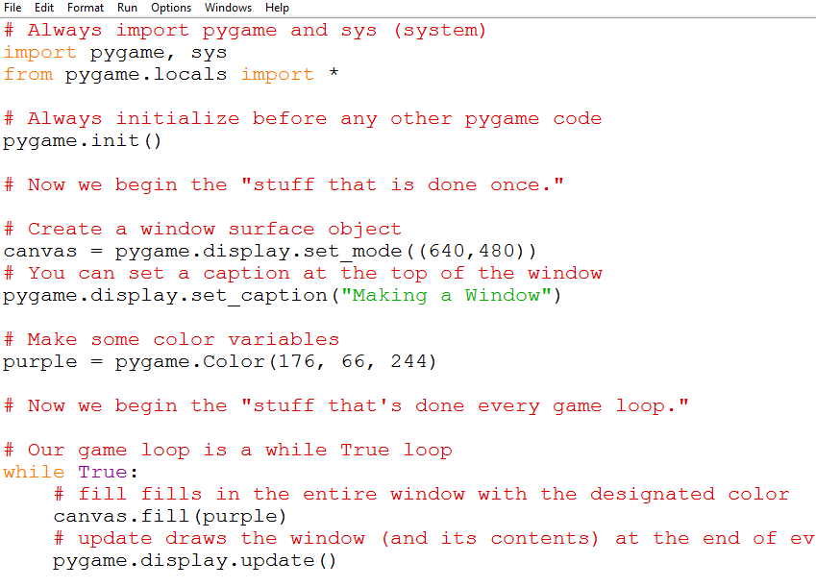

Slide 24
Event Handling
When making games, we deal with what we call “events”
e.g. Input from the player clicking the mouse or pressing buttons
In the main game loop, collect the events in a list (pygame makes this easy!), and we “handle” those events as appropriate
Notes:
(e.g. if the player presses the up arrow, their character moves up)
Events are handled in the game loop

Slide 25
Closing a Window
There are 2 ways of closing the window
Closing it when you click the X at the top right corner
Closing it when you press the <esc> key
You can use 1 or both of these ways

Slide 26
Code!
Modify the code above to handle closing the window with either method
ClosingAWindow.py

Slide 27
Drawing Shapes
Pygame provides several methods for drawing shapes
Shapes are drawn inside the game loop

Slide 28
Drawing Shapes: Code
The code for drawing shapes begins with:
pygame.draw.
The name of the shape you are drawing goes after the last dot
pygame.draw.rect()
pygame.draw.circle()

Slide 29
Drawing Shapes: Code
pygame.draw.rect(canvas, red, (12, 20, 50, 100))
The name of the surface on which to draw the shape
The color in which to draw the shape
The coordinates of where to draw the shape
The width and height of the shape

Slide 30
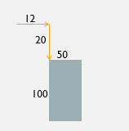
Drawing Shapes: Code
pygame.draw.rect(canvas, red, (12, 20, 50, 100))
The first 2 numbers (12 and 20 in this example) represent the position of the top left corner of the rectangle.
That position is the horizontal and vertical distances from the top left corner of the window (0,0)
The next 2 numbers (50 and 100) are the width and height of the rectangle

Slide 31
Drawing Shapes: Rectangle
pygame.draw.rect(window, color, (x, y, w, h), t)
window is the name of the window object (“canvas” in my code examples)
color is the color variable in which to draw the rectangle
x and y are the coordinates of the top left corner
w and h are the width and height of the rectangle
t is the thickness of the rectangle--it is optional; if blank or 0 it will fill in fully with color, otherwise the edge will be the designated thickness (with no color in the middle)

Slide 32
Drawing Shapes: Circle
pygame.draw.circle(window, color, (x, y), r, t)
window is the name of the window object (“canvas” in my examples)
color is the color in which to draw the circle
x and y are the coordinates of the center of the circle
r is the radius of the circle
t is the thickness of the circle--it is optional; if blank or 0 it will fill in fully with color, otherwise the edge will be the designated thickness (with no color in the middle)

Slide 33
Draw Documentation
https://www.pygame.org/docs/ref/draw.html

Slide 34
Drawing Images
We can add images into our games
(.jpg, .png)
You must have the image in the same folder as your python file
Resize the image (in MS Paint, Photoshop, etc.) to fit your needs
Make it the size of the screen to be a background image
Make it smaller to be the ball in a Pong-style game

Slide 35
Two Lines to Draw Images
Outside of the game loop (for example, where you initialize your colors), initialize the image variable
imageName = pygame.image.load(“filename.jpg")
“filename.jpg” is the name of the file of your image that is in the same folder as your python code (and, yes, you include the quotes inside the parentheses)
Inside the game loop, draw the image
canvas.blit(imageName, (x, y))
“canvas” is the name of the window in my examples. This tells it where to draw the image
imageName is the name of your variable that contains the image
x and y are the coordinates of the top left corner of the image

Slide 36
Code!
Modify the code above to draw some shapes!
DrawingImages.py

Slide 37
Drawing Shapes That Move
So far, the positions of the items we’ve drawn have been constant
pygame.draw.circle(canvas, teal, (320, 345), 50)
(320, 345) is constant—it always draws the circle there
If we make their positions variables, and update those variables each time we re-enter the game loop, we can make the items move
We’ll go into this in more detail next week

